Slide 1
WeTube Android Edition
Egan Bower, Hunter Hults, Colin Woodard, Michael Capelotti

Slide 2
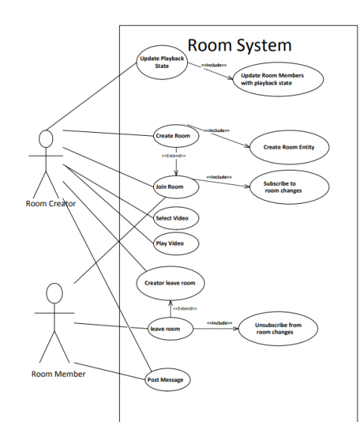
Key features

Slide 3
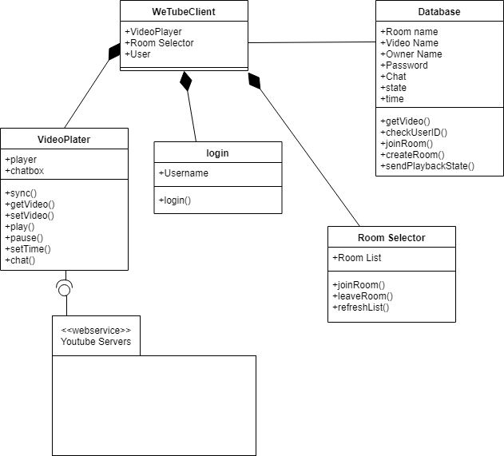
Design concepts

Slide 4
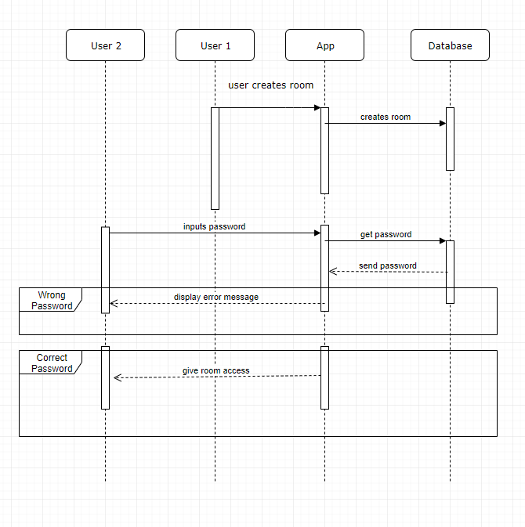
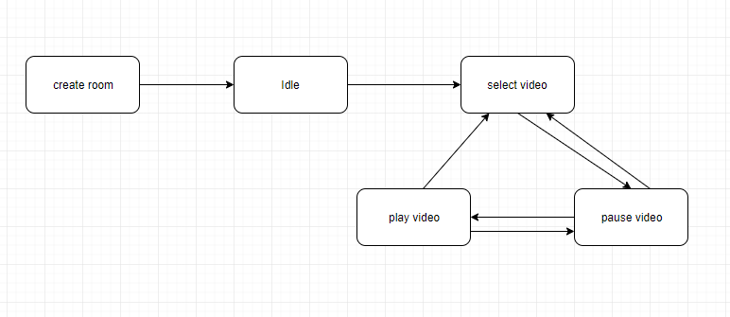
System behaviors

Slide 5
Progress update
Functionally complete
No Authentication/User accounts
Friends list was not implemented
Chat history minimal
Crude Video Selection

Slide 6
System Demonstration
https://www.youtube.com/watch?v=iIDCpumR_IM

Slide 7
Lessons Learned
Third Party APIs/SDKs don’t always have great instructions for their services so you have to brute force your way through to figure it out.
The development process for any program is a rocky slope that is full of potholes and roadblocks.
Different considerations have to be made for mobile programming.

Slide 8
Questions?

